Slide 1
Notice of Adverse Benefit Determination (NOABD)
The CFR 42 Final Rule replaced the term “Action” with “Adverse Benefit Determination”. Which means we will send out NOABDs in place of NOAs (Notice of Action).
The definition of an “Adverse Benefit Determination” encompasses all previous elements of “Action” with the inclusion of determinations involving medical necessity, appropriateness, setting of covered benefits, and financial liability.
These NOABD forms will only be issued to Medi-Cal beneficiaries

Slide 2
Beneficiaries must receive a written NOABD when the Plan takes any of the following actions:
The denial or limited authorization of a requested service, including determinations based on: the type or level of service, medical necessity, appropriateness, setting, or effectiveness of a covered benefit;
The reduction, suspension, or termination of a previously authorized service;
The denial, in whole or in part, of payment for a service;
The failure to provide services in a timely manner;
The failure to act within the required timeframes for standard resolution of grievances and appeals; or
The denial of a beneficiary’s request to dispute financial liability.

Slide 3
There are 9 templates used in response to the aforementioned Adverse Benefit Determinations
1045-Denial
1045-Delivery System
1045-Termination
1045-Modification
1045-Payment Denial
1045-Timely Access
1045-Authorization Delay
1045-Grievance/Appeal Resolution
1045-Financial Liability
These forms are available on the blue page!

Slide 4
Timing of the Notice
For termination, suspension, or reduction of a previously authorized specialty mental health and/or DMC-ODS service, at least 10 days before the date of action, except as permitted under 42 CFR §§ 431.213 and 431.214;
For denial of payment, at the time of any action denying the provider’s claim;
For decisions resulting in denial, delay, or modification of all or part of the requested specialty mental health and/or DMC-ODS services, within two business days of the decision.
The Plan must also communicate the decision to the affected provider within 24 hours of making the decision

Slide 5
Written NOABD Template attachments
Plans must use DHCS’ uniform notice templates, which are available in AVATAR and are posted on the intraweb (DHHS’ blue page), when providing beneficiaries with a written NOABD.
Each NOABD sent must also include the following attachments:
QI-108 NOABD Know Your Rights,
QI-109 Beneficiary Non-Discrimination Notice, and
QI-110 Language Assistance Taglines

Slide 6
Transition from NOA to NOABD Crosswalk
“Action” or “Adverse Determination” | Past Form | Current Form
1. Denial or limited authorization of a requested service, including determinations based on the type or level of service, medical necessity, appropriateness, setting, or effectiveness of a covered benefit; | 1045-A | 1045- Denial, 1045-Delivery System
2. The reduction, suspension, or termination of a previously authorized service; | 1045-B | 1045-Termination, 1045-Authorization Delay
3. The denial, in whole or in part, of payment for a service; | 1045-C | 1045-Payment Denial
4. The failure to provide services in a timely manner; | 1045-E | 1045-Timely Access, 1045-Authorization Delay
5. The failure to act within the required timeframes for standard resolution of grievances and appeals; | 1045-D | 1045-Grievance/Appeal Resolution
6. The denial of a beneficiary's request to dispute financial liability. | No prior NOA | 1045-Financial Liability

Slide 7
NOABD Action and associated Form
NOABD Action
NOABD Form
The denial or limited authorization
The reduction, suspension, or termination of a previously authorized service;
The denial, in whole or in part, of payment for a service;
The failure to provide services in a timely manner;
The failure to act within the required timeframes for standard resolution of grievances and appeals; or
The denial of a beneficiary’s request to dispute financial liability.
1045-Termination, 1045-Modification
1045-Denial, 1045-Delivery System
1045-Payment Denial
1045-Timely Access, 1045-Authorization Delay
1045-Grievance/Appeal Resolution
1045-Financial Liability

Slide 8
The NOABD must explain all of the following:
The adverse benefit determination the Plan has made or intends to make.
A clear and concise explanation of the reason(s) for the decision.
ie. For determinations based on medical necessity criteria, the notice must include the clinical reasons for the decision.
A description of the criteria used.
This includes medical necessity criteria, and any processes, strategies, or evidentiary standards used in making such determinations
The beneficiary’s right to be provided upon request and free of charge, reasonable access to and copies of all documents, records, and other information relevant to the beneficiary’s adverse benefit determination.

Slide 9
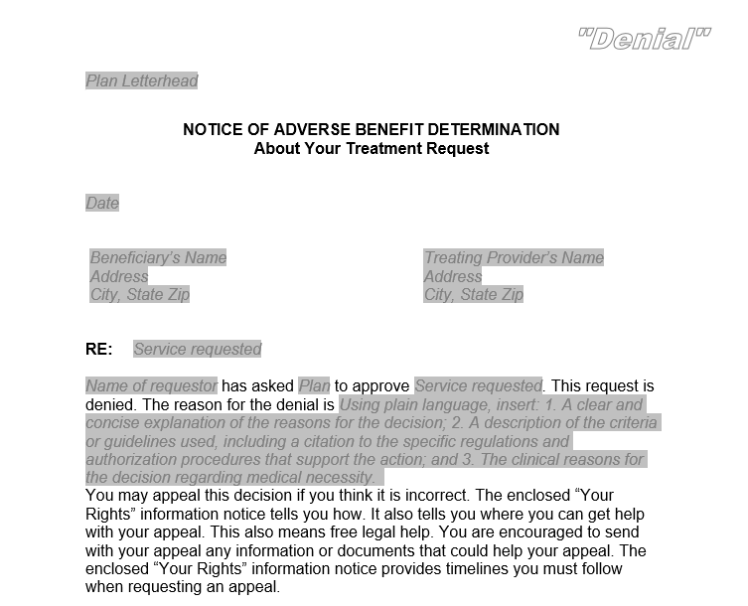
1045-Denial
A denial includes determinations based on type or level of service, requirements for medical necessity, appropriateness, setting or effectiveness of a covered benefit.
This is the form that was previously called 1045-A (Assessment).
This will be used by Access Staff and/or LPHA when a client does not meet medical necessity for specialty mental health services.

Slide 10
1045-Denial Example
Alice comes in with family for an assessment due to difficulty with memory, confusion, and nonsensical speech and they are worried she is mentally ill. After gathering information and completing an assessment, the clinician finds that she meets criteria for dementia, which is an excluded primary diagnosis. Alice is denied services. Clinician sends 1045 – Denial letter.

Slide 11
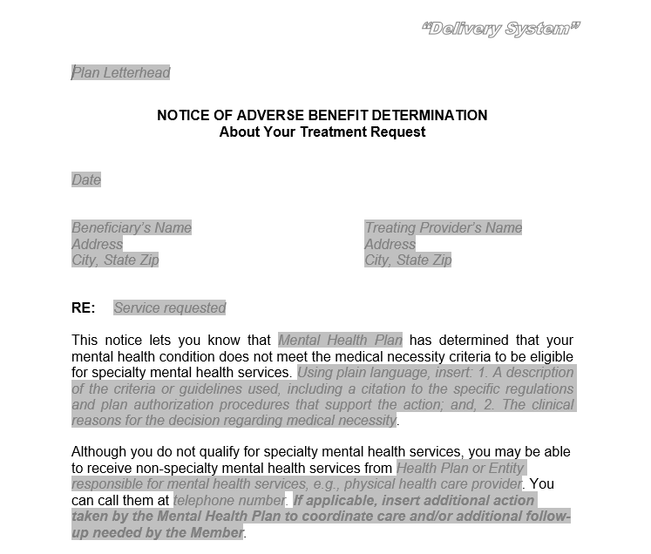
1045-Delivery System
This form is used if the beneficiary does not meet medical necessity criteria for specialty mental health services but is referred to a Managed Care Plan (MCP), for example Beacon, for non-specialty mental health services.
This is the form that was previously called 1045-R (Referral)
This form will also be used by Access Staff and/or LPHA when a referral to an MCP is made.

Slide 12
1045-Delivery System Example
Martha, George’s Mom, calls the children’s clinic in order to request access to mental health services for George. George has difficulty listening to her requests to complete his chores and she reports that he has started talking back more. After completing an assessment, an access clinician decides he would be best served at a lower level of care and refers him to Beacon. Access clinician sends 1045 – Delivery System letter.

Slide 13
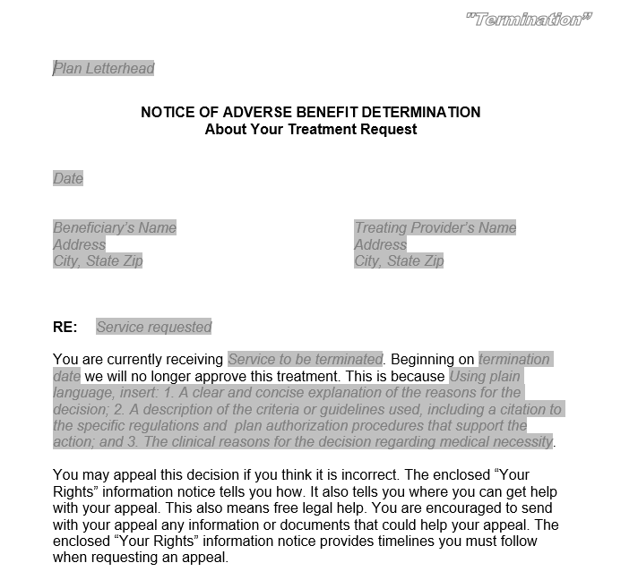
1045-Termination
This form is used when the MHP decides to terminate, reduce, or suspend a previously authorized service.
This is the form that was previously called 1045-B.
This form will be used by the LPHA making the decision to terminate.

Slide 14
1045-Termination Example
Sasha has been attending individual therapy through older adults for the past year and a half. Her original treatment goal of addressing grief and anxiety, related to the death of her spouse, has been met and therefore she is ready to close. Sasha disagrees with her therapist and wants to continue services. Clinician sends 1045 – Termination letter.

Slide 15
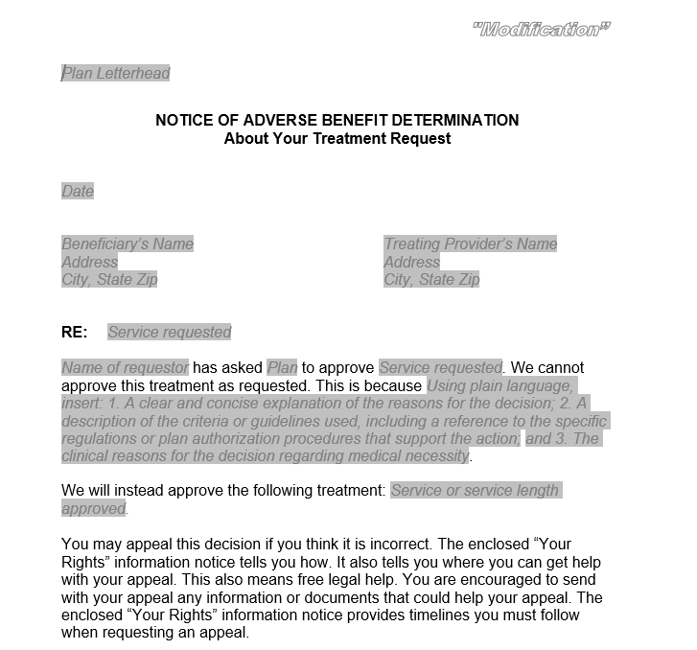
1045-Modification
This form is used when the MHP modifies or limits a provider’s request for a service, which includes an increase or decrease or alteration to type of services.
This is the form that was previously called 1045-B.
This form is used by Access staff working to approve, modify or deny access with organizational providers.

Slide 16
1045-Modification Example
A provider requests to have a beneficiary placed in a half-day, day treatment intensive program five days per week, but the MHP modifies that request and approves two individual psychotherapy sessions (50 minutes each) three times per week, plus one group psychotherapy session (90 minutes) once per week, plus attendance at a Wellness Center two times per week, including a check-in with a Wellness Center peer counselor. Since we, the MHP, have modified the authorization request, we must issue a 1045-Modification.

Slide 17
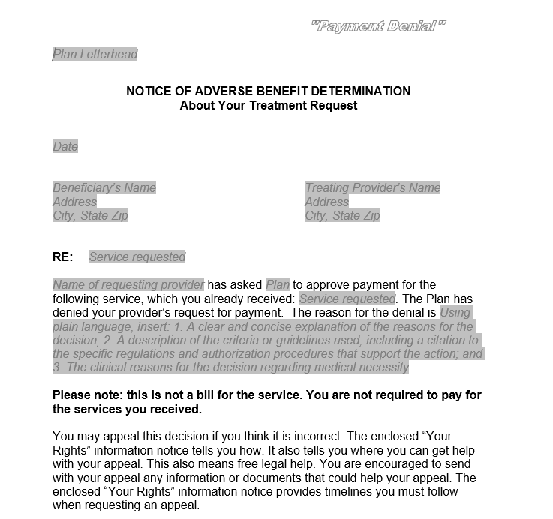
1045-Payment Denial
The 1045-Payment Denial would be used by the LPHA in the Utilization Review when a client no longer meets medical necessity after the service has already been delivered.
This is the form that was previously called 1045-C.
This form is used by Quality Improvement/Utilization Review Staff.

Slide 18
1045-Payment Denial Example
Fred is hospitalized out of county for the last two weeks, transferred from CSU, due to danger to self. The out of county hospital sends medical record for review by QI/UR staff to determine payment for rendered services. Charting shows no evidence of medical necessity related to suicidal ideation for the last two days of his stay and therefore payment is denied for those two days. QI/UR staff sends 1045 – Payment Denial letter.

Slide 19
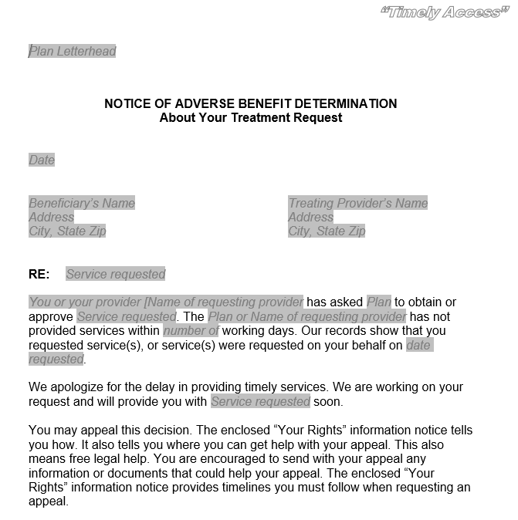
1045-Timely Access
This form is used when a beneficiary is not offered an appointment in a timely manner, with respect to state and federal timeliness standards.
This is the form that was previously called 1045-E.
This form is utilized by Access staff

Slide 20
1045-Timely Access Examples
Sally calls on September 22nd in order to request specialty mental health services and the appropriate information is entered on the RAS log. Sally is offered an appointment for an assessment on October 12th, which is beyond our 10 day standard. The access staff or clinician sends 1045 – Timely Access letter.
Based on Michael’s assessment and treatment plan completed on October 1st it is determined that he would benefit from medication support. Michael is offered a medication support appointment on October 18th, which is beyond the 14 day standard. The Clinician sends 1045 – Timely Access letter.

Slide 21
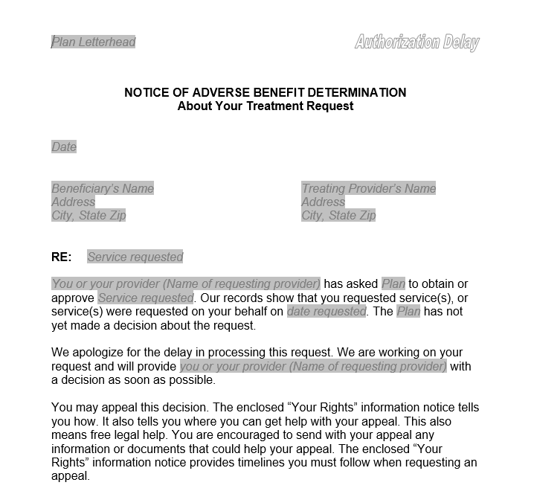
1045-Authorization Delay
This form is used when there is a delay in processing a provider’s request for authorization or when the MHP extends the timeframe to make an authorization decision, including: extensions granted at the request of the beneficiary or provider, and/or those granted when there is a need for additional information, and when it is in the benefit of the beneficiary.
No match to prior 1045/NOA form.
This is used by Access staff.

Slide 22
1045-Authorization Delay Example
A Service Authorization Request (SAR) was received by a Children’s Access Clinician on April 12th from Star View (a contracted out-of-county organizational provider) and the service authorization date is April 28th. This is outside of our 14 day window.

Slide 23
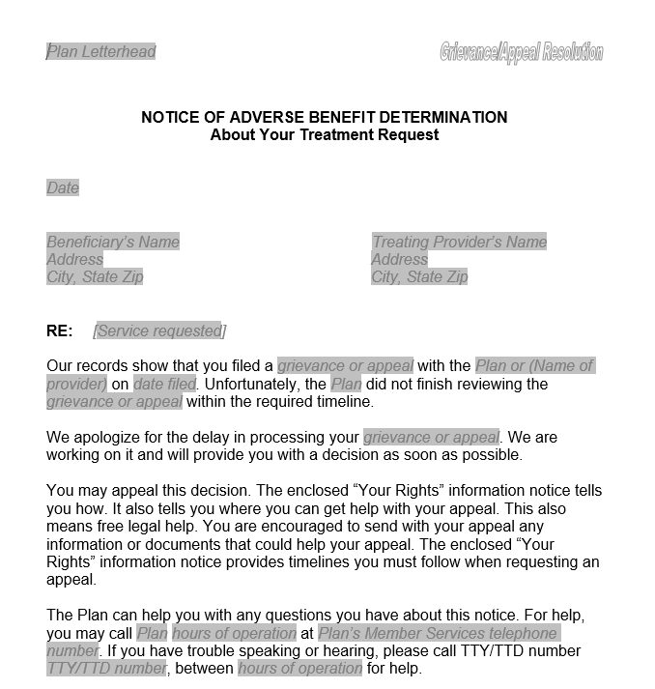
1045-Grievance/Appeal Resolution
This form is used when a grievance and/or appeal is not resolved within the standard 60 day timeframe.
This is the form that was previously called 1045-D.
This form is used by whichever staff member was assigned by QI to work toward resolution with the beneficiary.

Slide 24
1045-Grievance/Appeal Resolution Example
Tyler submitted a client problem resolution form (grievance) stating his concern about staff behavior while being on our inpatient unit. An acknowledgement letter was sent stating that it would take up to 60 days for resolution and identified the Director of Nursing as the responsible party for resolution. 60 days had passed and no resolution was determined due to high demands and being under staffed. The Director of Nursing sends the 1045-Grievance/Appeal Resolution.

Slide 25
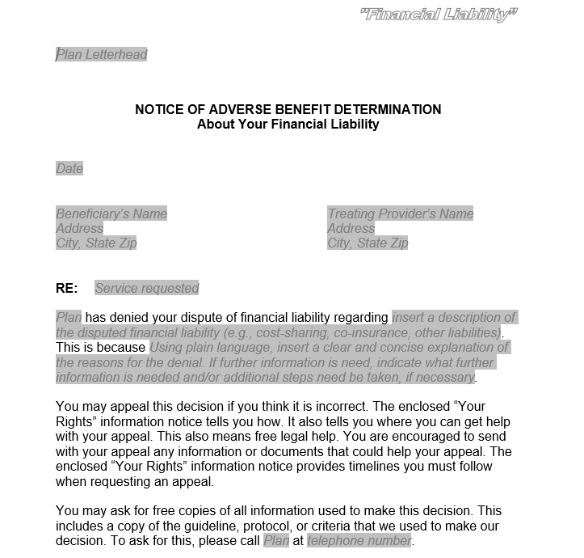
1045-Financial Liability
This form is used when the CDM denies a beneficiary their request to dispute financial liability.
No match to a prior 1045/NOA form.
CDM staff dealing with the particular claim use this form.

Slide 26
1045-Financial Liability Example
A beneficiary contacts the billing department due to receiving a bill for their co-payment, and the billing department concludes the cost-sharing bill is correct. Billing department staff will issue a 1045-Financial Liability form.

Slide 27
Process for sending NOABDs
Send completed NOABD form with QI-108 NOABD “Your Rights”, QI-109 Non Discrimination Notice, and QI-110 Language Assistance Tag Lines to beneficiary within expected timeframes (they vary per type of adverse decision)
Email copy of packet, along with any supporting documentation, to QI for tracking
Send packet by interoffice mail to Medical Records for scanning into Avatar

Slide 28

NOABD letters help our consumers understand their rights
Thank you for the work you do to ensure consumers have a quality level of care.

